Slide 1




ACT: Architectural Carbon Modeling Tools
@ MICRO 2024
Tutorial
Udit Gupta, Leo Han

Slide 2
ACT Tutorial: Today
Time | Topic
1:00 – 1:15pm | Introductory remarks
1:15 – 1:30pm | Sustainable Computing: Motivation and Challenges
1:30 – 2:15pm | Overview of ACT: An Architectural Carbon Modeling Tool
2:15 – 2:45pm | Hands-on ACT demo
2:45 – 3:00pm | Extending ACT
3:00 – 3:30pm | Break
3:30 – 4:30pm | Invited Talks: Tools for Carbon Accounting
4:30 – 5:00pm | Discussion
5:00 – 5:05pm | Closing Remarks
Notes:
Finally, given our understanding of carbon emissions, we will conclude by charting paths for how to design future sustainable computing systems.

Slide 3

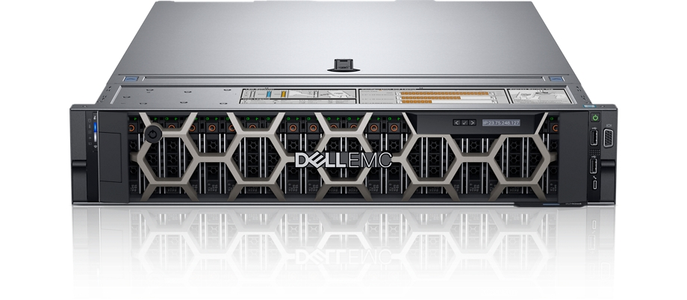
Estimating the embodied footprint of 2 devices using ACT
IC component | ACT vs. Dell R740 server LCA | ACT vs. Fairphone 3 mobile device LCA
Compute (processors, SoC’s) | Within 2.2x | Within 1.18x
Memory | Within 1.62x | Within 2.1x
Storage | Within 1.05-2.2x
Takeaways
ACT provides first-order approximation of LCAs that use old technology nodes (45nm NAND, 32nm CPU)
ACT enables architects to study new technology nodes

Slide 4

How to set up ACT
>$ git clone https://github.com/S4AI-CornellTech/ACT.git
>$ cd ACT/
>$ source setup.sh
>$ python3 model.py
https://github.com/S4AI-CornellTech/ACT.git
[Fab logic] Carbon/area from energy consumed 1209.5
[Fab logic] Carbon/area from gasses 240
[Fab logic] Carbon/area from materials 500
[Fab logic] Carbon/area aggregate 2228.0
Notes:
Note: Add units

Slide 5
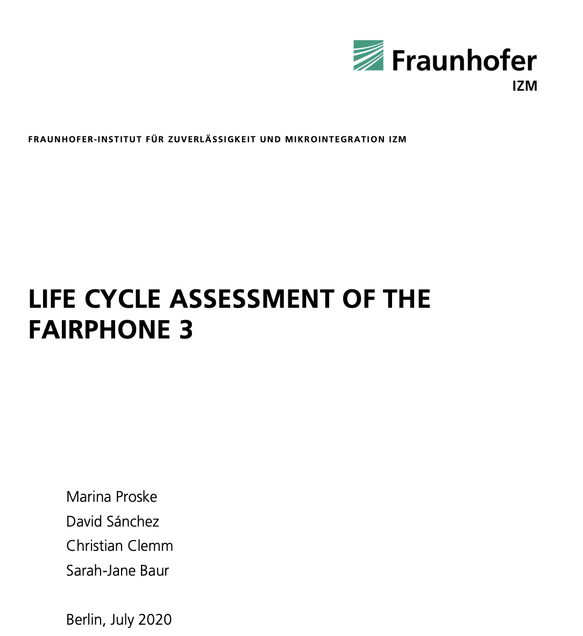
Estimating embodied footprint of Fairphone 3
https://www.fairphone.com/wp-content/uploads/2020/07/Fairphone_3_LCA.pdf
# Make sure you are in root directory
>$ cd ACT
>$ python3 tutorial/fairphone3_tutorial.py
--------------------------------
ACT RAM + Flash 0.0 kg CO2 vs. LCA 11 kg CO2
ACT CPU 0.0 kg CO2 vs. LCA 1.07 kg CO2
ACT ICs 0.0 kg CO2 vs. LCA 5.3 kg CO2
Full end to end example can be found here: https://github.com/S4AI-CornellTech/ACT/blob/main/exps/fairphone3/fairphone3.py

Slide 6
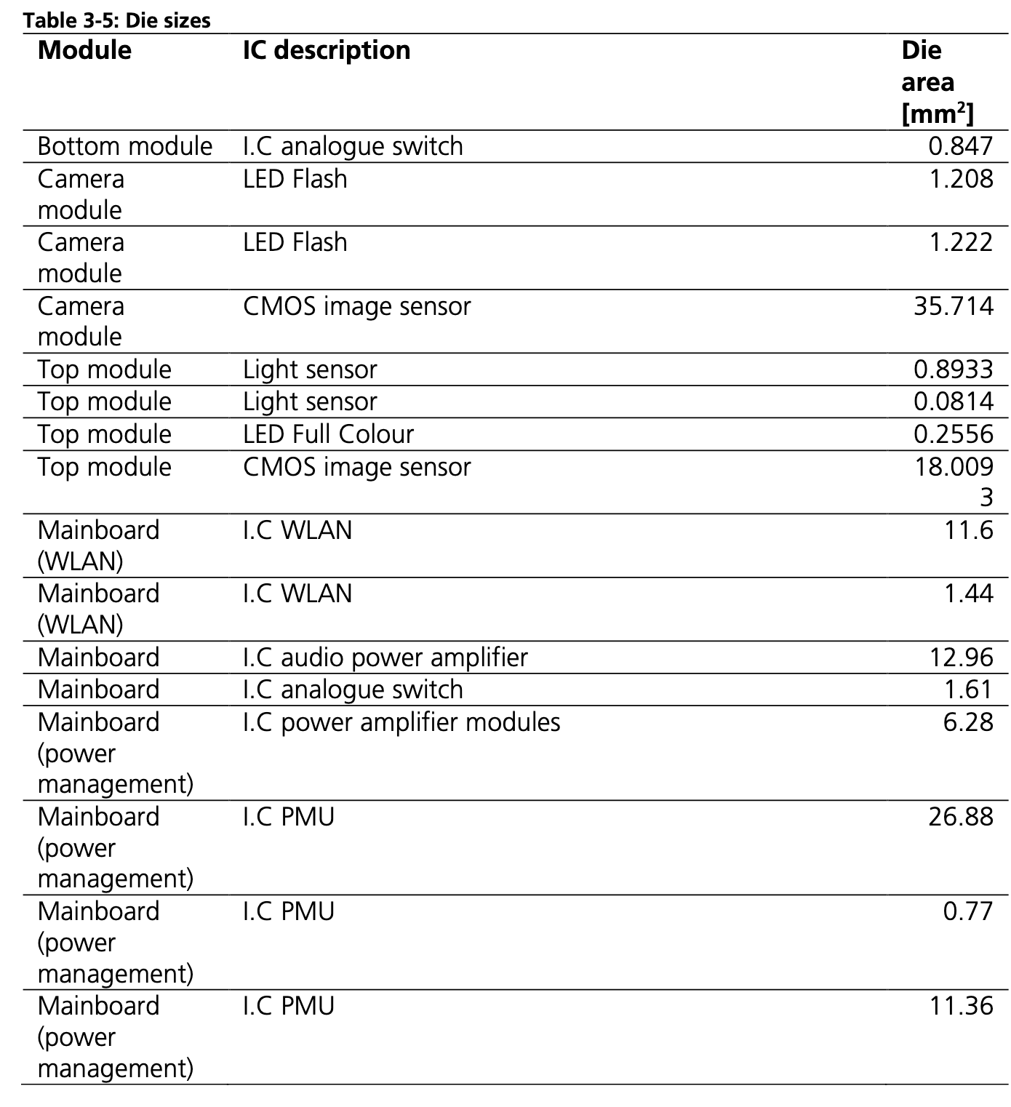
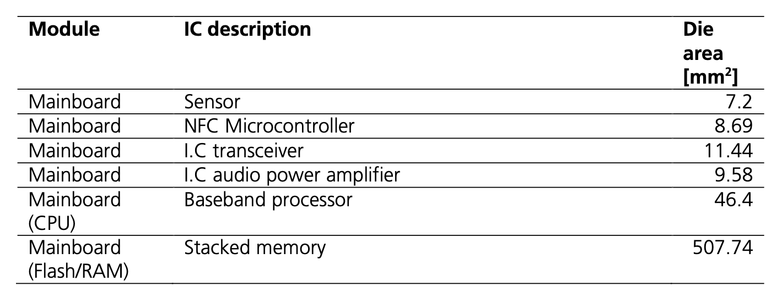
Finding die areas for ICs in the Fairphone 3
https://www.fairphone.com/wp-content/uploads/2020/07/Fairphone_3_LCA.pdf
# Main Fairphone integrated circuits' areas in mm^2
# https://www.fairphone.com/wp-content/uploads/2020/07/Fairphone_3_LCA.pdf
# Look at page 22 (Table 3-5)
fairphone3_IC_areas = []

Slide 7
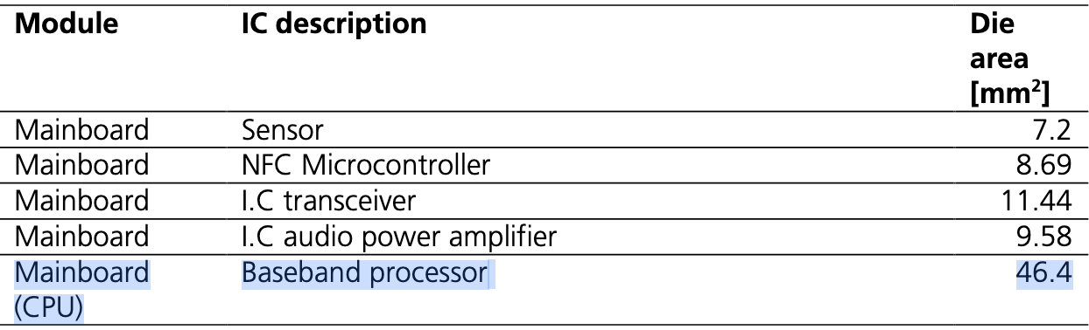
Specifying CPU, DRAM, SSD and Yield
https://www.fairphone.com/wp-content/uploads/2020/07/Fairphone_3_LCA.pdf
fairphone_cpu_area = 46.4 #mm^2
fairphone_ram = 4 # GB
fairphone_storage = 64 # GB
ic_yield = 0.875

Slide 8
Setting up ACT for IC Logic
IC_Logic = Fab_Logic(
gpa = "95",
carbon_intensity = "src_coal",
process_node = 28,
fab_yield=ic_yield)
gpa = {“95”, “99”}
carbon_intensity = {“src_{energy_source}”, “loc_{country}”}
process_node = {28, 20, 14, 10, 8, 7, 5, 3}
fab_yield = yield where 0 <= yield <= 1

Slide 9
Setting up ACT for CPU Logic
IC_Logic = Fab_Logic(
gpa = "95",
carbon_intensity = "src_coal",
process_node = 28,
fab_yield=ic_yield)
CPU_Logic = Fab_Logic(
gpa = "95",
carbon_intensity = "src_coal",
process_node = 28,
fab_yield=ic_yield)

Slide 10
Setting up ACT for DRAM and SSD
For all DRAM and SSD configs, see config files in /dram/ and /ssd/ folders
# DRAM Logic node
DRAM = Fab_DRAM(
config = "ddr3_50nm", fab_yield=ic_yield)
# SSD Logic node
SSD = Fab_SSD(
config = "nand_30nm", fab_yield=ic_yield)

Slide 11
Computing the IC Carbon Footprint
IC_Logic.set_area(sum(fairphone3_IC_areas)/100.)
# area in cm^2
CPU_Logic.set_area(fairphone_cpu_area/100.)
# area in cm^2
DRAM.set_capacity(fairphone_ram)
SSD.set_capacity(fairphone_storage)
packaging_intensity = 150 # gram CO2

Slide 12
Estimating embodied footprint of Fairphone 3
# Make sure you are in root directory
>$ cd ACT
>$ python3 tutorial/fairphone3_tutorial.py
--------------------------------
ACT RAM + Flash 5.310285714285714 kg CO2 vs. LCA 11 kg CO2
ACT CPU 0.8992937142857143 kg CO2 vs. LCA 1.07 kg CO2
ACT ICs 5.691643885714286 kg CO2 vs. LCA 5.3 kg CO2

Slide 13
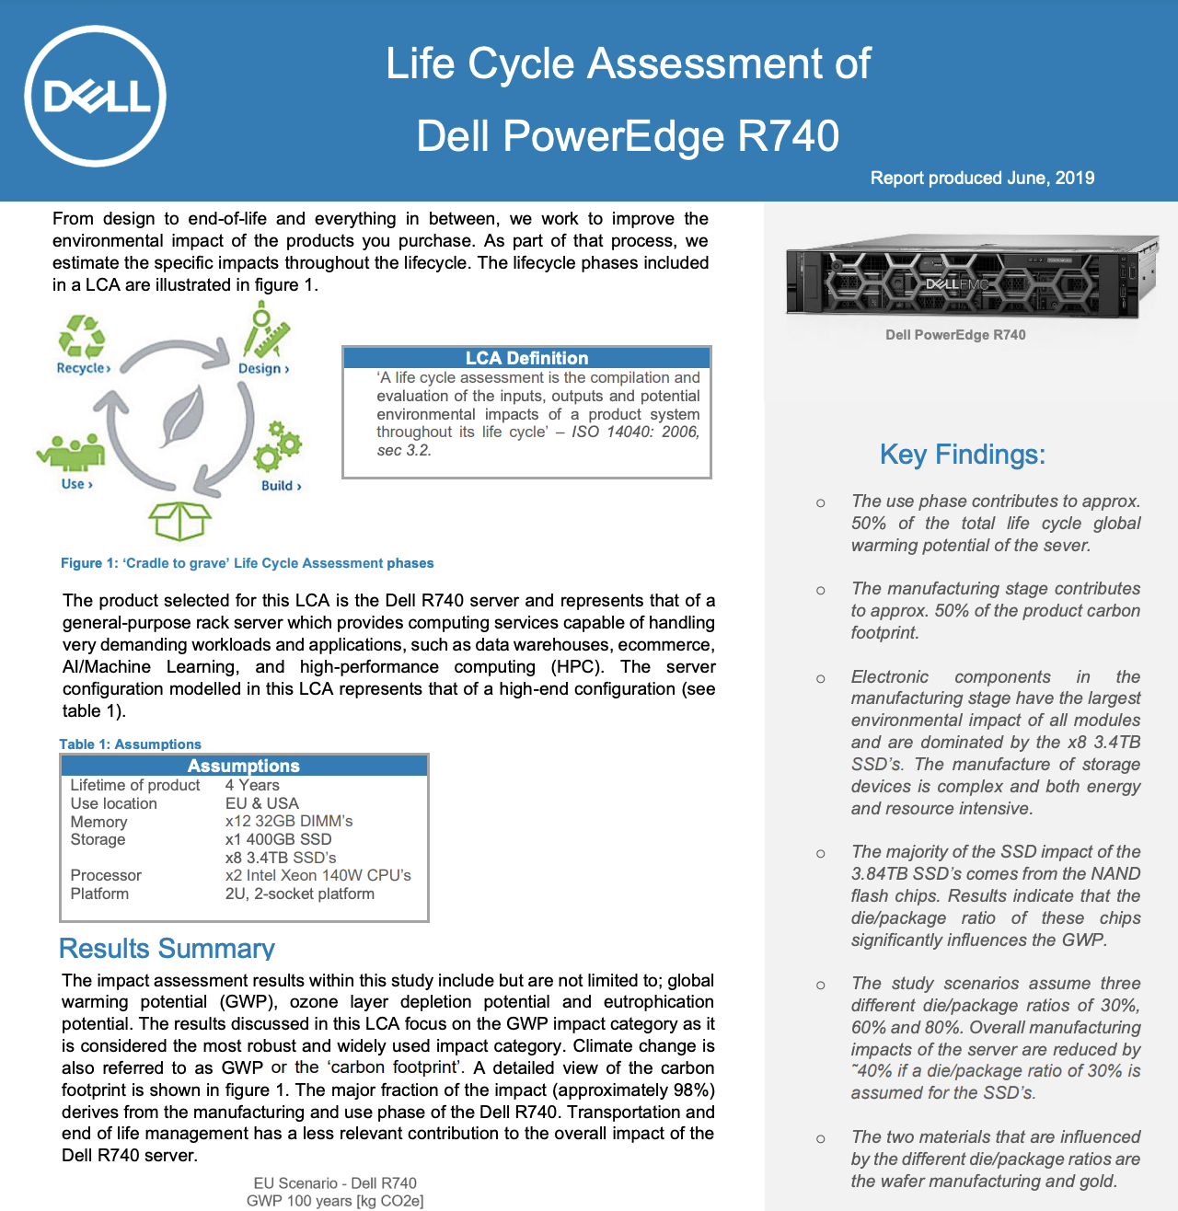
Estimating embodied footprint of Dell R740
https://corporate.delltechnologies.com/content/dam/digitalassets/active/en/unauth/data-sheets/products/servers/lca_poweredge_r740.pdf
# Make sure you are in root directory
>$ cd ACT
>$ python3 tutorial/dellr740_tutorial.py
--------------------------------
ACT SSD main 0 kg CO2 vs. LCA 3373 kg CO2
ACT SSD secondary 0 kg CO2 vs. LCA 64.1 kg CO2
ACT DRAM 0 kg CO2 vs. LCA 533 kg CO2
ACT CPU 0 kg CO2 vs. LCA 47 kg CO2
Full end to end example can be found here: https://github.com/S4AI-CornellTech /ACT/blob/main/exps/dellr740/dellr740.py

Slide 15
ACT Tutorial: Today
Time | Topic
1:00 – 1:15pm | Introductory remarks
1:15 – 1:30pm | Sustainable Computing: Motivation and Challenges
1:30 – 2:15pm | Overview of ACT: An Architectural Carbon Modeling Tool
2:15 – 2:45pm | Hands-on ACT demo
2:45 – 3:00pm | Extending ACT
3:00 – 3:30pm | Break
3:30 – 4:30pm | Invited Talks: Tools for Carbon Accounting
4:30 – 5:00pm | Discussion
5:00 – 5:05pm | Closing Remarks
Notes:
Finally, given our understanding of carbon emissions, we will conclude by charting paths for how to design future sustainable computing systems.

Slide 16
Estimating embodied footprint of Nvidia A100
https://corporate.delltechnologies.com/content/dam/digitalassets/active/en/unauth/data-sheets/products/servers/lca_poweredge_r740.pdf
# Make sure you are in root directory
>$ cd ACT
>$ python3 tutorial/dellr740_tutorial.py
--------------------------------
ACT SSD main 0 kg CO2 vs. LCA 3373 kg CO2
ACT SSD secondary 0 kg CO2 vs. LCA 64.1 kg CO2
ACT DRAM 0 kg CO2 vs. LCA 533 kg CO2
ACT CPU 0 kg CO2 vs. LCA 47 kg CO2
Full end to end example can be found here: https://github.com/S4AI-CornellTech /ACT/blob/main/exps/dellr740/dellr740.py

